Slide 1
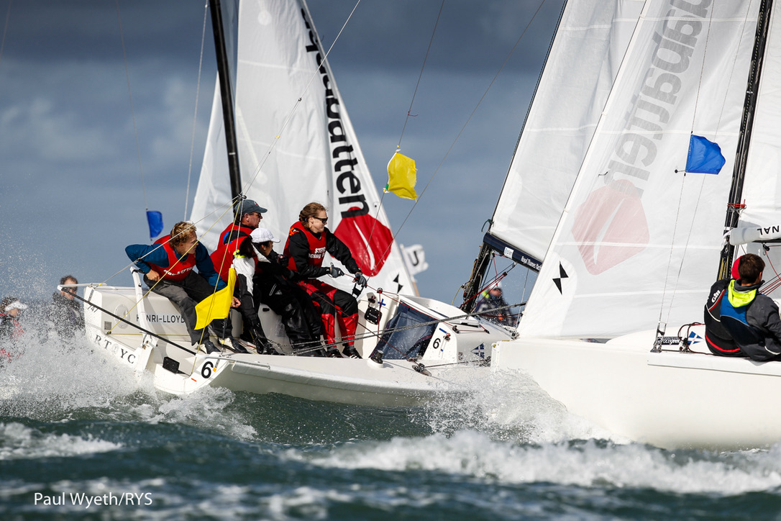
UMPIRING 2K

Slide 2
Some Rule Changes
RRS 17 is deleted
RRS 18.4 is deleted
RRS 31 changed to the MR version.. No hull or body contact.
Voluntary Penalty.. Prestart and on legs to Mark 1 a gybe (immediate)
Voluntary Penalty on all other legs..a tack (immediate)
Umpire Penalties a tack and a gybe (immediate)
A tack is complete when on a close hauled course
A gybe is complete when the main sail lies on the new leeward side.

Slide 3
Boat Allocation
We track the boats with the lowest numbers…here Yellow 1 and Yellow 2

Slide 4
Boat Allocation
The Lead Umpire Boat takes the lower of the low…Yellow 1

Slide 5
Boat Allocation
The Second Umpire Boat takes the higher of the low…Yellow 2

Slide 6
Tracking and Calling
The Driving Umpire tracks and calls the Yellow boat

Slide 7
Tracking and Calling
The Non Driving Umpire tracks and calls the Blue boats that become an issue to the Yellow boat.

Slide 8
Prestart
Each Umpire tracks his own boat.

Slide 9
Its seems just like Match Racing…

Slide 10
But there is another pair
Beware!

Slide 11
Approaching the Line to Start
… if Match Racing

Slide 12
Approaching the Line to Start
… if Team Racing

Slide 13
At the Start
If a boat hits a mark and is OCS…

Slide 14
She can spin round the mark…
One gybe like this and all is OK (Not like MR)

Slide 15
After the Start
Umpires keep with your boat…left and right.

Slide 16
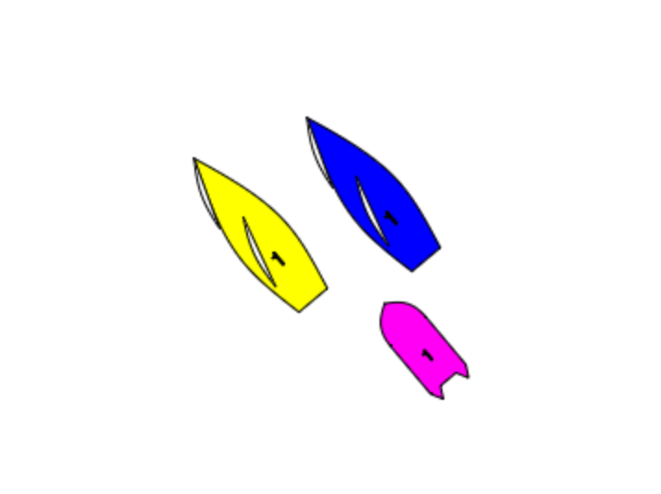
And keep Very Close
You need to see the gap between the boats, and both tillers… and talk about what the boats will do next.

Slide 17
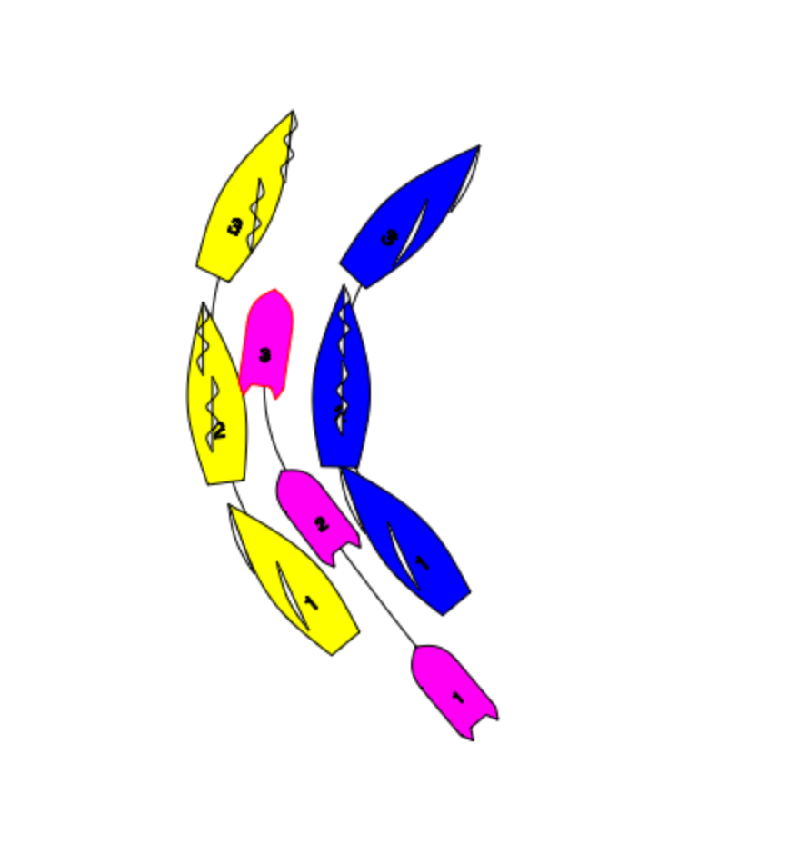
By keeping REALLY close you are always there to see any infringements.

Slide 18
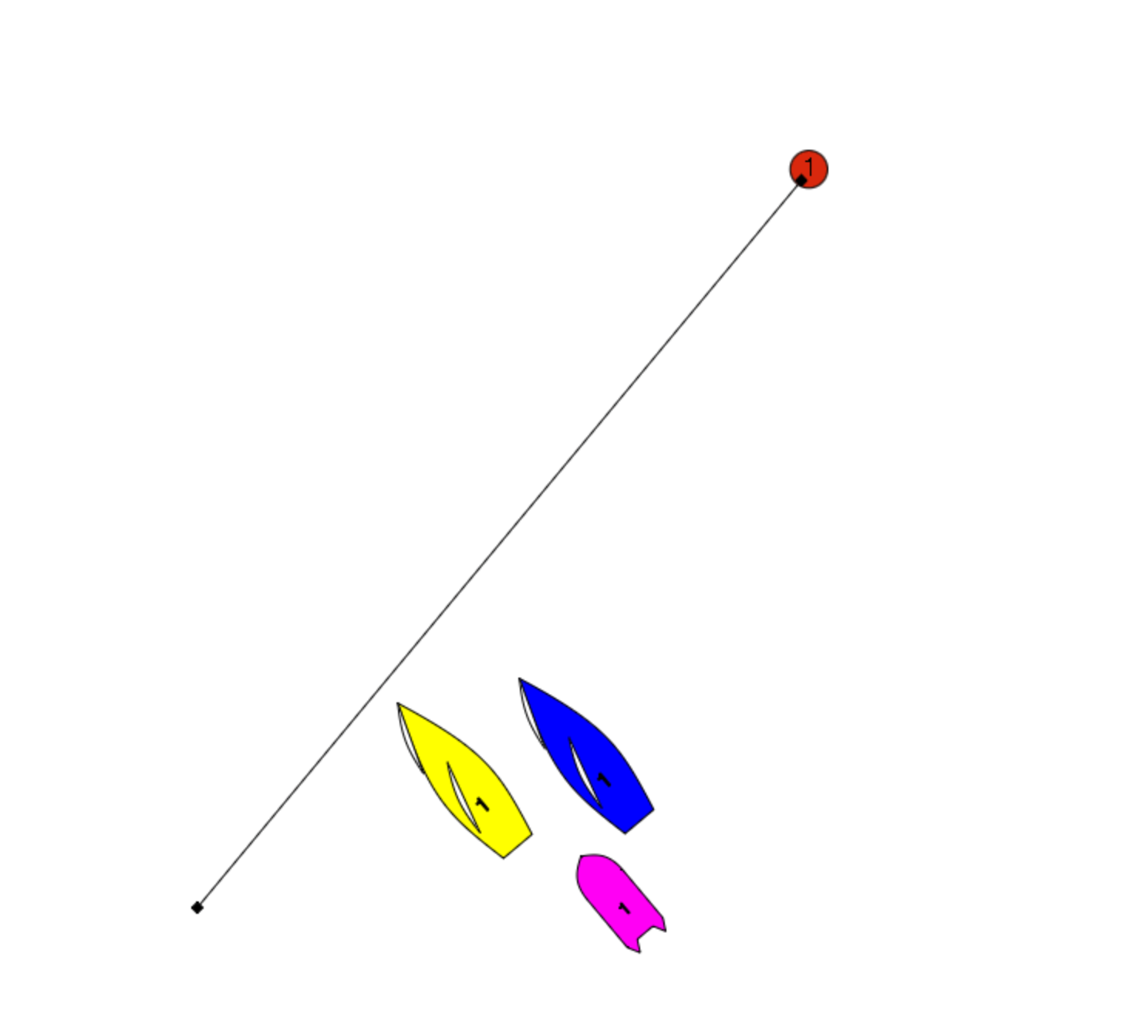
Anticipation: What is likely to happen next?
Yellow is going to gybe out

Slide 19
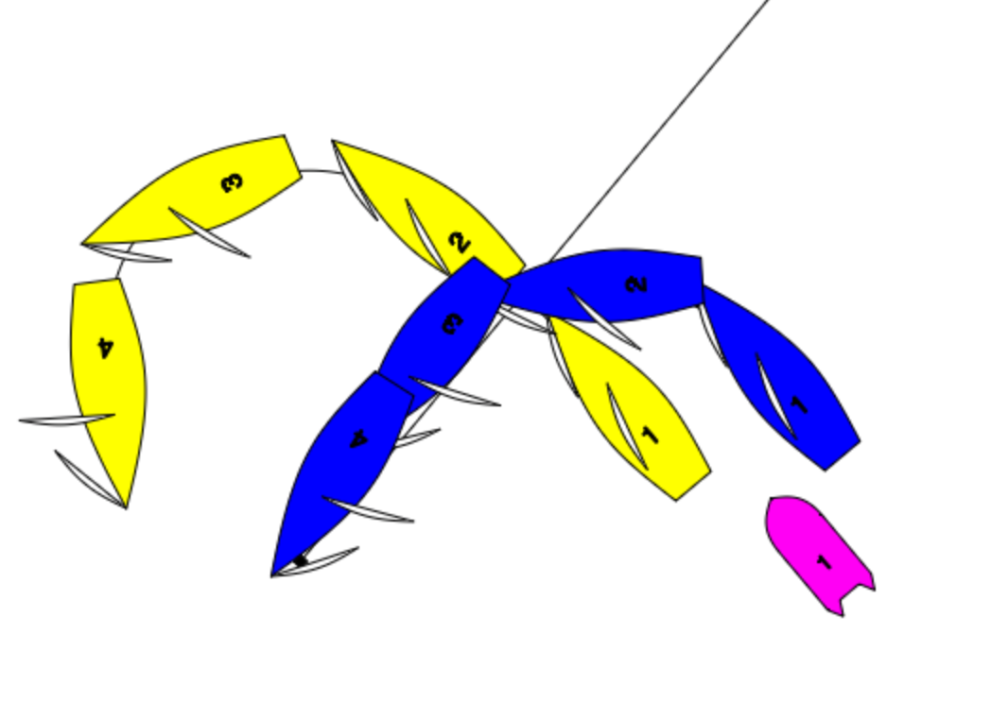
Where do you want to be?
In the gap to see the what happens if Yellow Gybes…

Slide 20
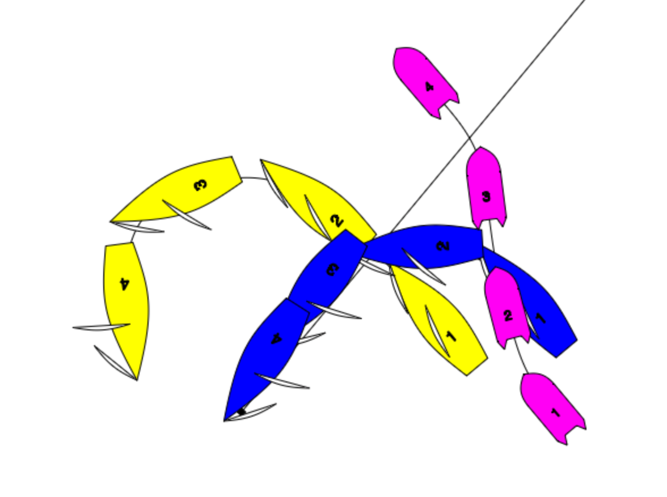
BUT

Slide 21
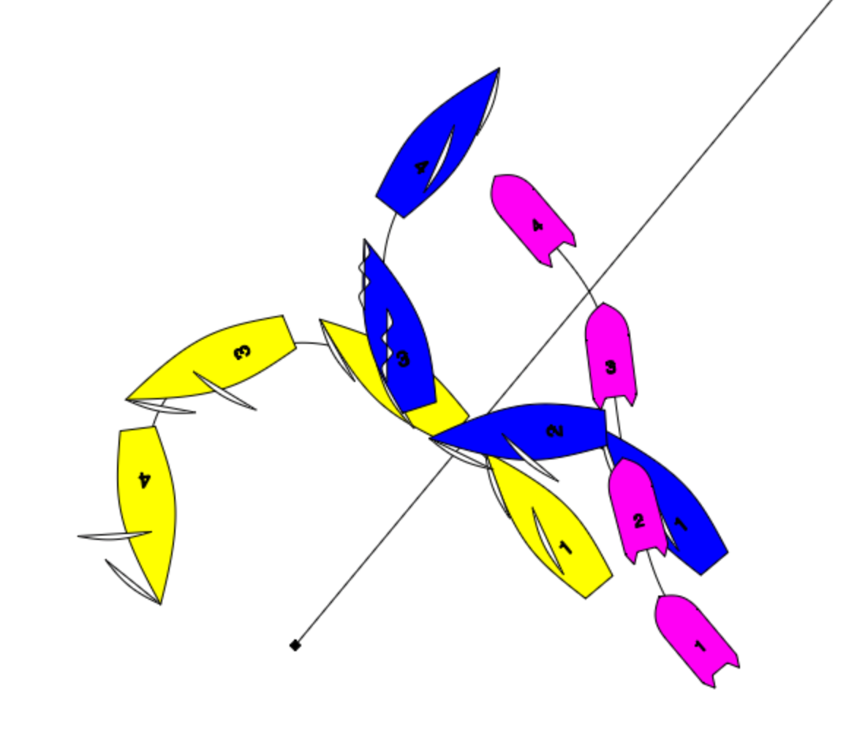
…Not ideal! So maybe…

Slide 22
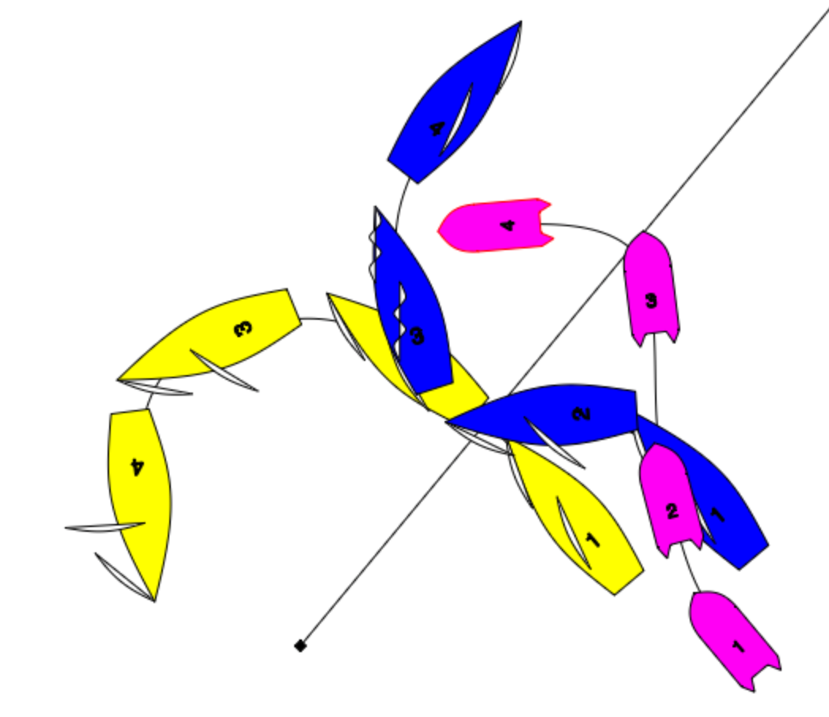
By keeping close you have the options.

Slide 23
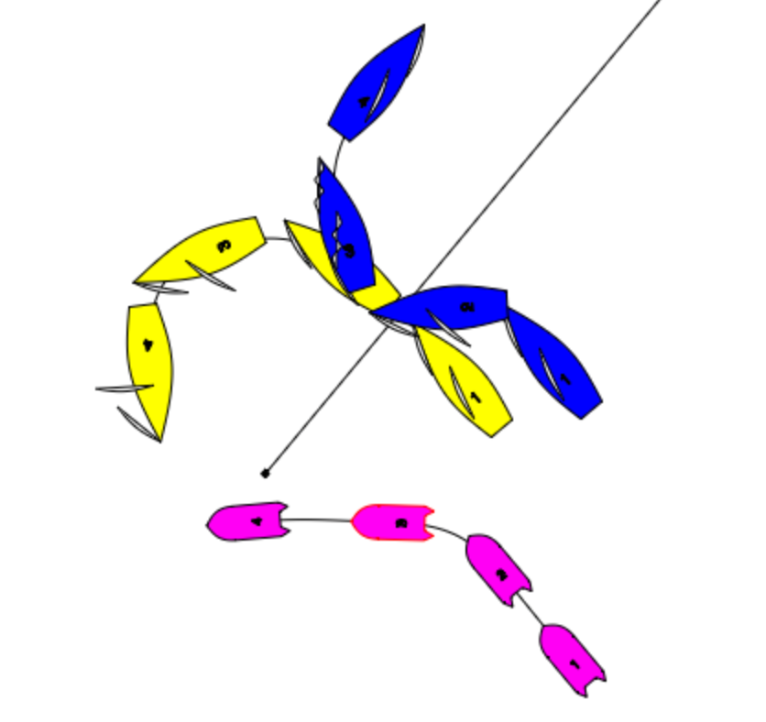
And then there is the Titanic Option.
The Umpire is too far away, out of position and is likely to be T-Boned by Yellow and certainly will see nothing.

Slide 24
Crosses
BUT Keep Close!
Keep with your pair.

Slide 25
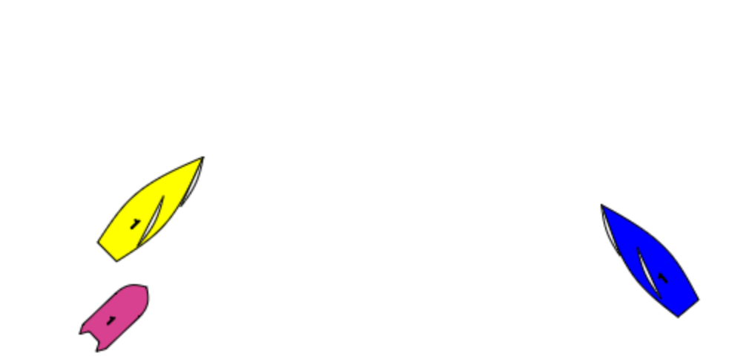
In Team Racing the game is all about control. So when you see this there are only Four Options:

Slide 26
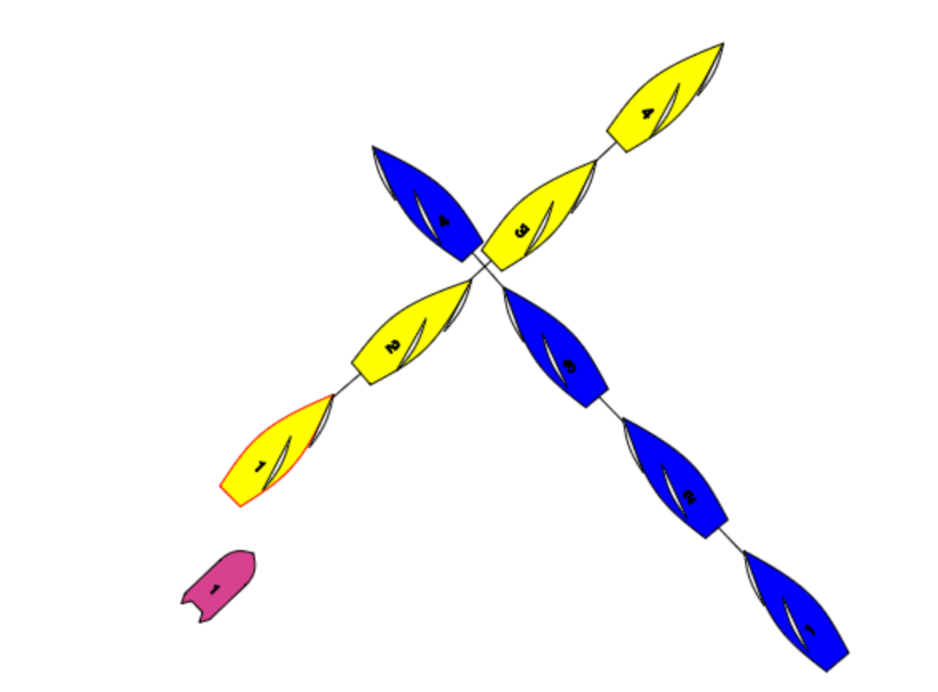
The simple cross
As Umpires you need to be deciding and calling “Is Yellow Keeping Clear”
You need to watch Blue’s steering… if she points up at Position 2.5 can Yellow “Keep Clear”
And at the ”Cross” where should the umpire be?

Slide 27
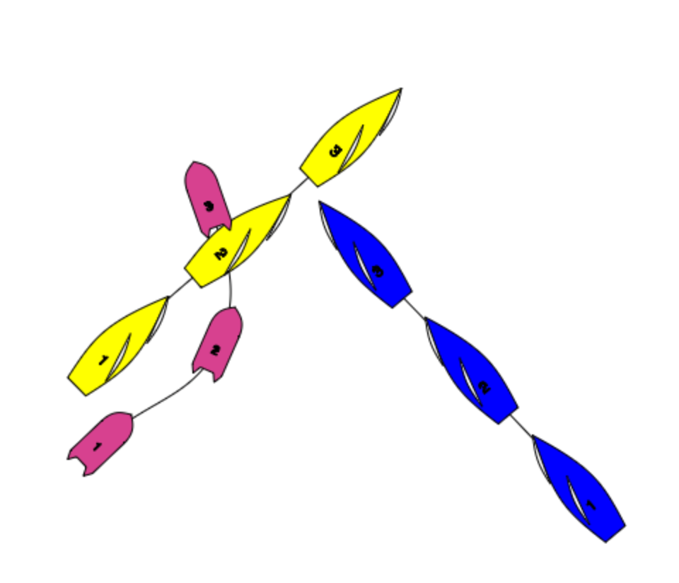
If you are certain Yellow will sail straight on… and this is likely in a 2-3 approaching a windward mark.

Slide 28
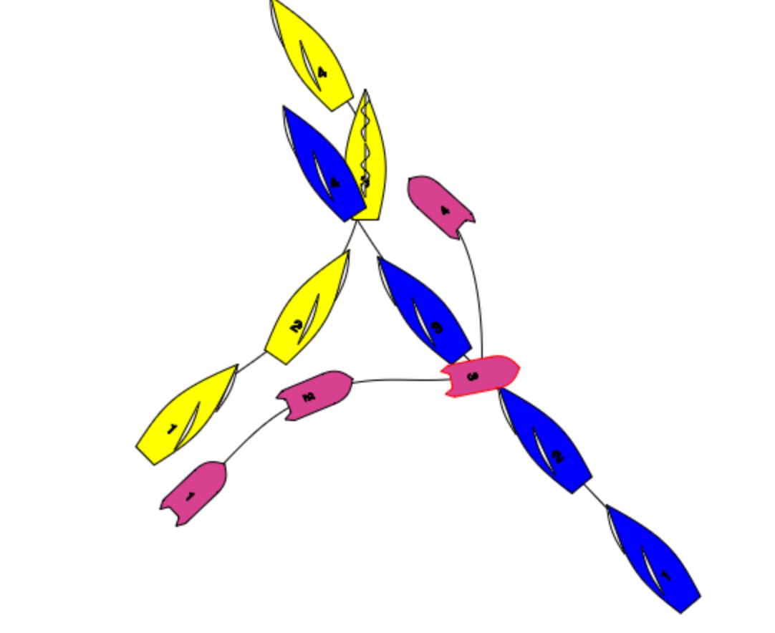
But if you think Yellow may tack to cover.
If Yellow tacks close there will be a Protest!

Slide 29
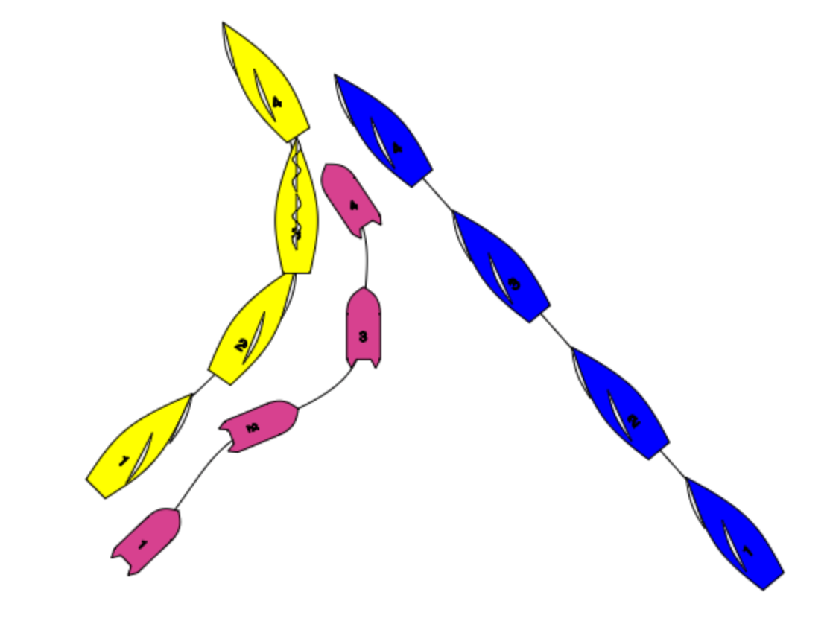
Option 3 The Lee Bow Tack
What we need to know:
Does Blue need to change course before Yellow gets to a close hauled course (RRS 13). And when Yellow has completed her tack can Blue keep clear (RRS 15)

Slide 30
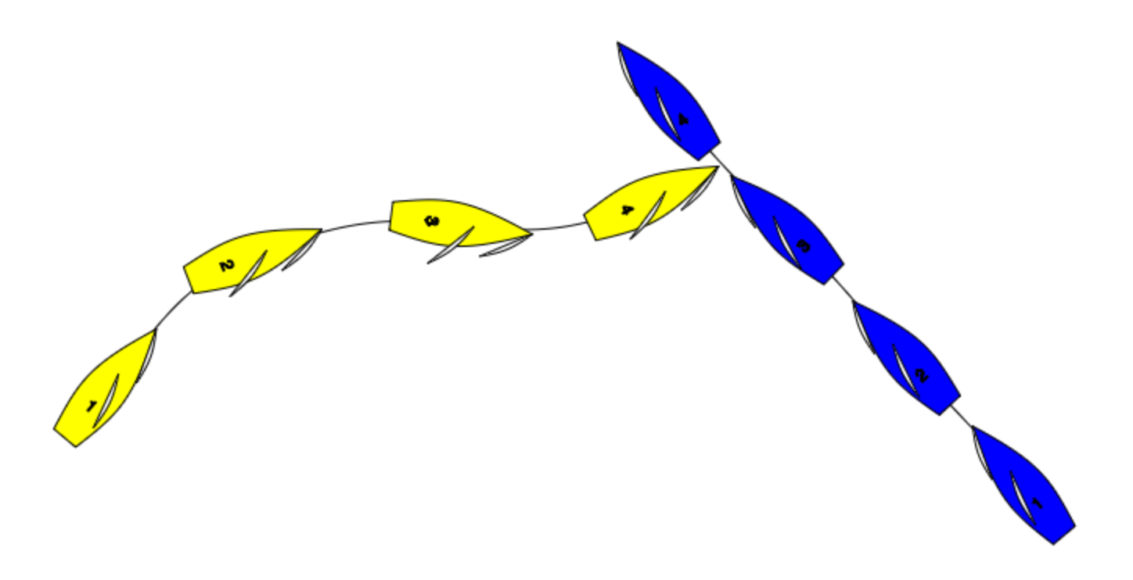
Option 4- Sailing to pass to leeward
Approaching a windward mark Yellow wants the right… so will often sail to pass to leeward of Blue.
Blue on the other hand would prefer to keep Yellow on the left.

Slide 31
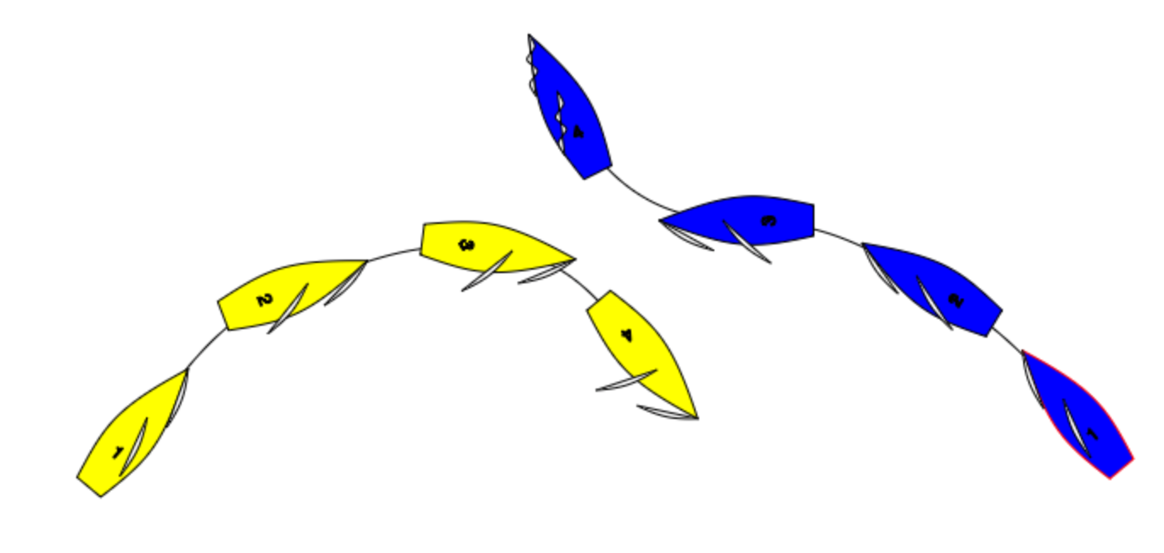
So we can get a “Dial Down”
And if we do we have a possibility of an RRS 16.2 Infringement

Slide 32
Rule 16.2
“In addition,
On a beat to windward
When a port tack boat is keeping clear by sailing to pass to leeward of a starboard tack boat
The starboard tack boat shall not bear away if as a result the port tack boat must change course immediately to continue keeping clear.

Slide 33
Looking at this Dial Down
Question 1: Are the boats on a beat to windward?
Answer 1: YES
Question 2: Is Yellow keeping clear by sailing to leeward?
Answer 2: YES
Question 3: Does Starboard bear away such that Port must change course immediately to continue keeping clear?
YES to all three questions. Blue breaks 16.2

Slide 34
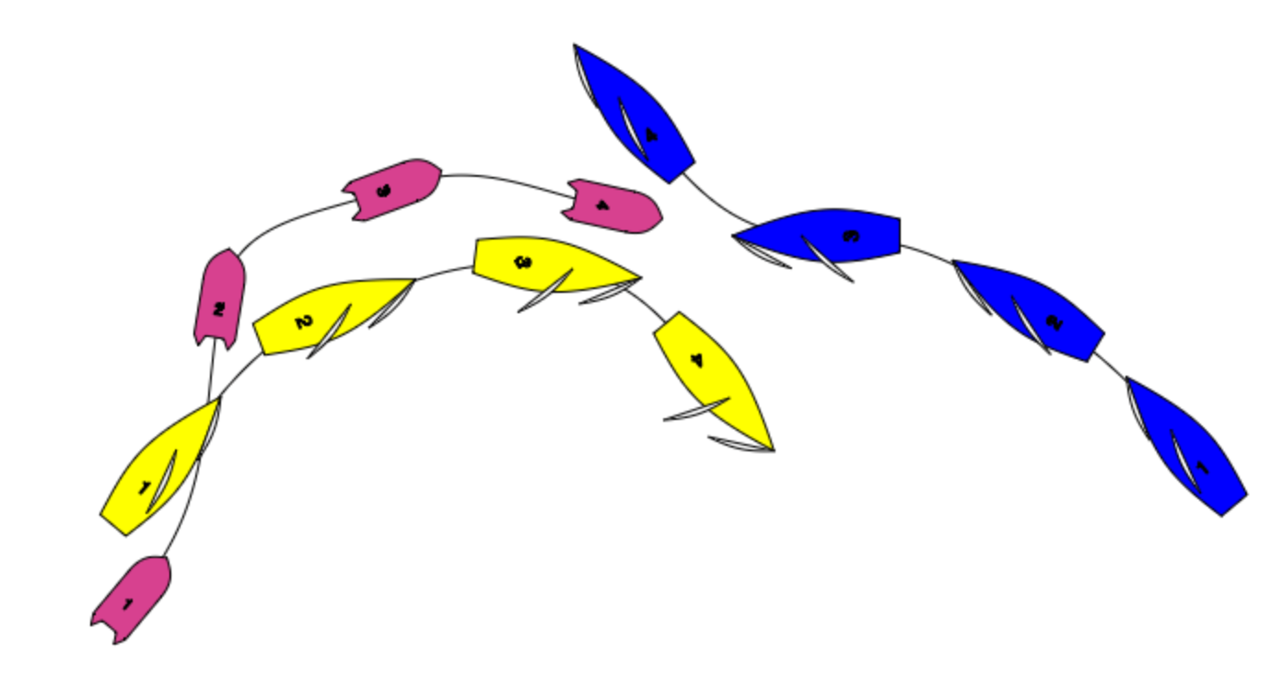
Umpiring a Dial Down
Just as you do in Match Racing…looks scary but it isn’t and it works.

Slide 35
Back to positioning

Slide 36
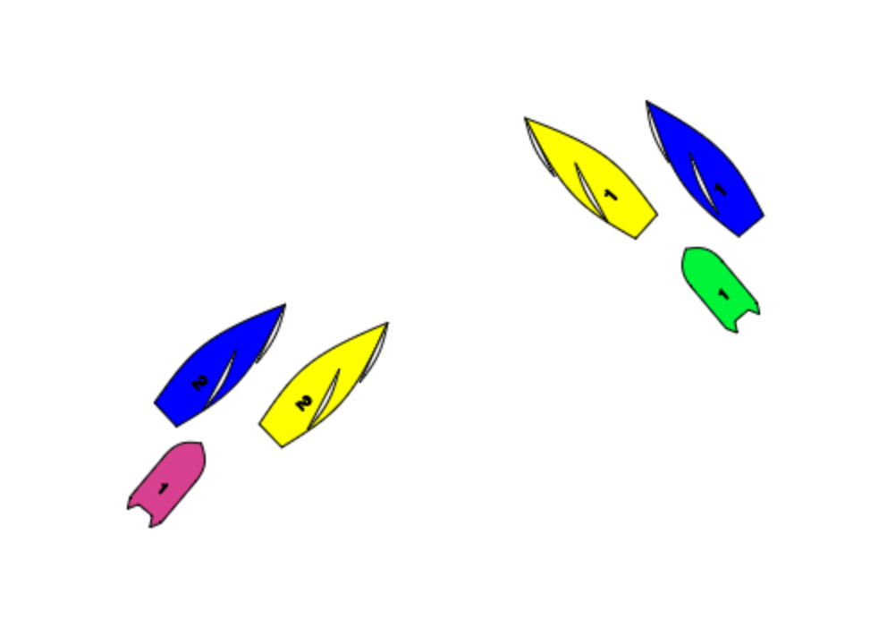
Close Crossing
Track own boat..and keep with your pair but watch the other pair

Slide 37
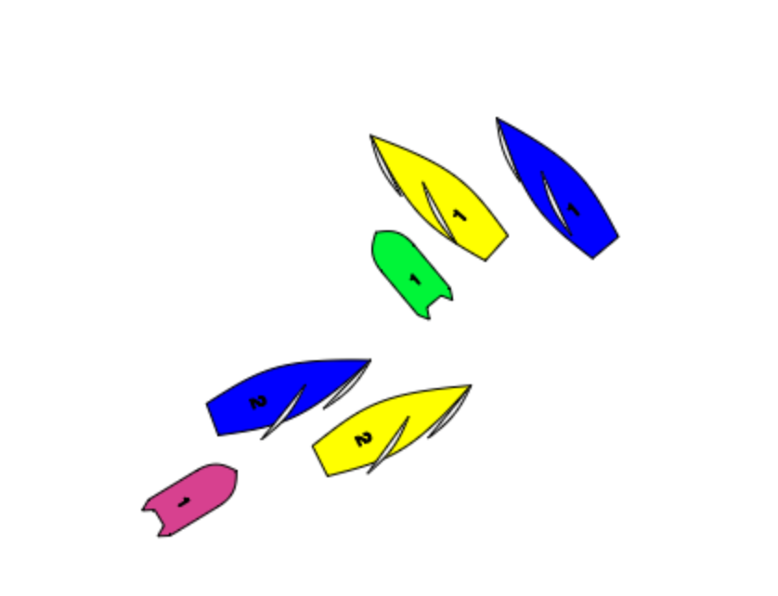
If very close…
Green Umpire Rib can go to leeward of Yellow 1

Slide 38
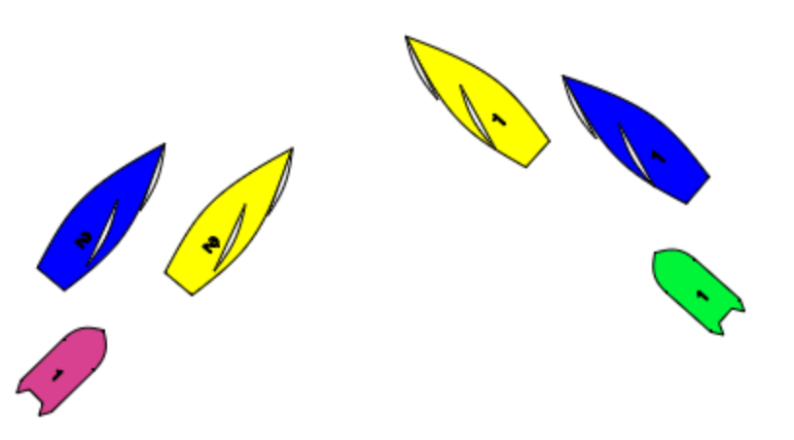
Team Tactics on the beat 1.
As in diagram Yellow is last.
But if she hails for room to tack..

Slide 39
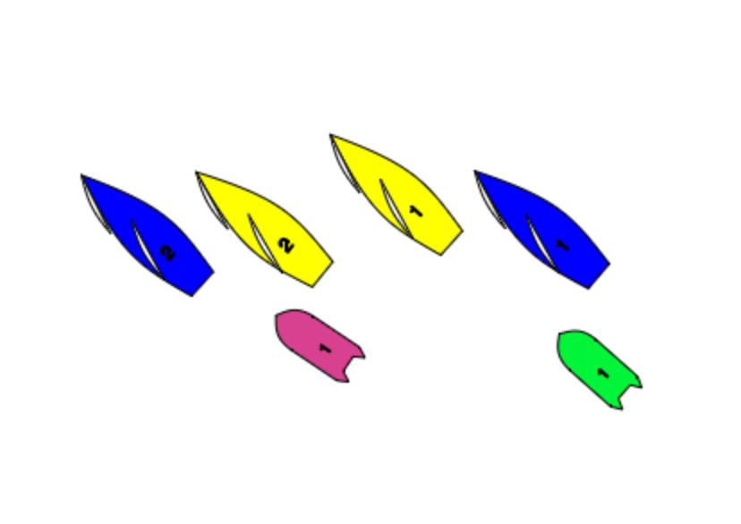
We have this… and Yellow are winning.

Slide 40
Helping the Other Umpire
With keelboats often very easy to become unsighted.
Keep your head out of the boat and be aware of the other pair.
Radio if you see “Contact”
Radio “I can Call” ( hand vertically above head)
Reply “You Call” (point at the umpire)
If no reply… beware of calling unless…

Slide 41
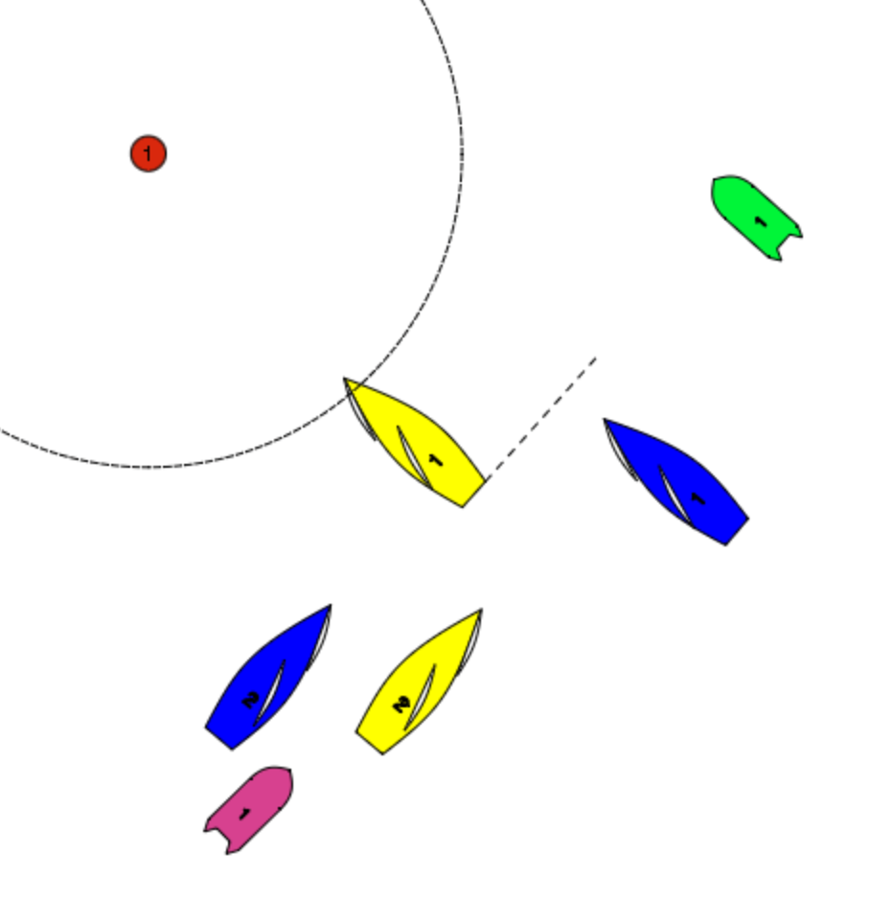
Approaching the Zone
Umpire of lead pair goes outside
To check zone overlaps
Umpire of trailing pair stays astern

Slide 42
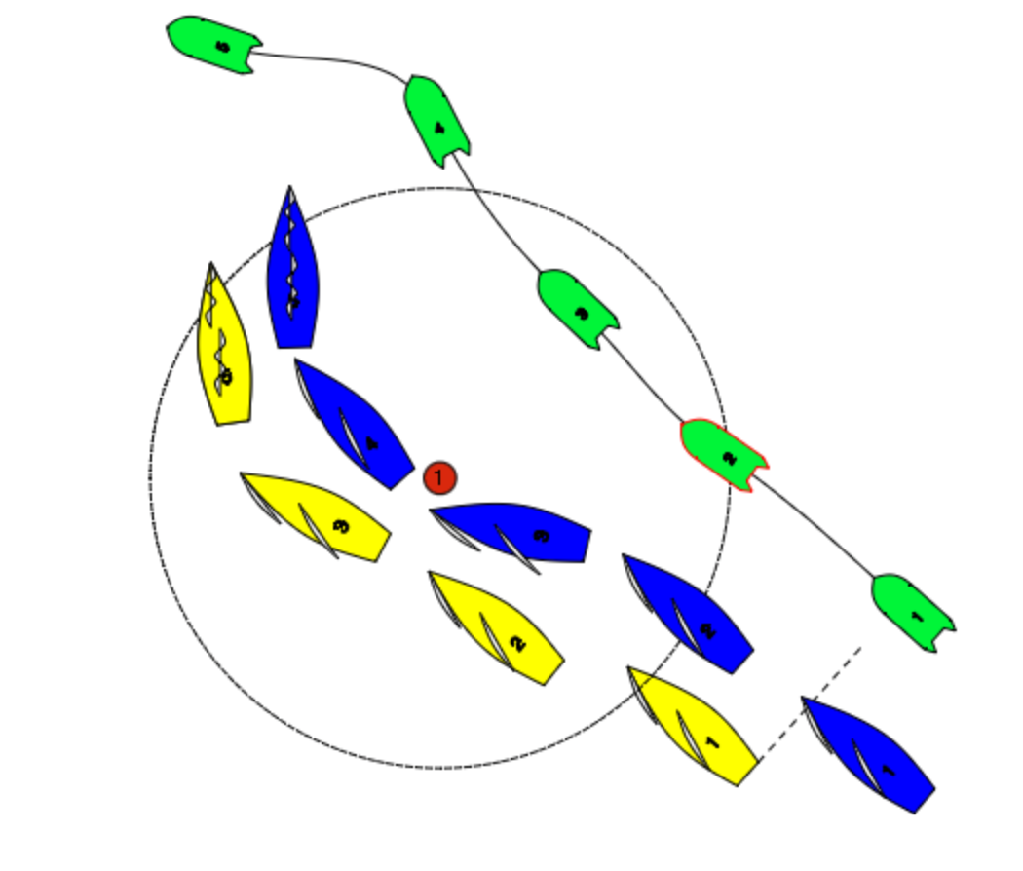
At the mark-lots of rules
At position 1 Yellow must bear away to give mark room to Blue.

Slide 43
At the mark-lots of rules
At position 3 Yellow must give room for Blue to tack.

Slide 44
At the mark-lots of rules
After position 3 Yellow has given mark room for Blue to tack. Blue has not tacked so RRS 18 switches off and Blue as Windward Boat must keep clear.
Blue often does this to allow a team mate to get ahead.
The Umpire should position above to look down the gap between the boats.

Slide 45
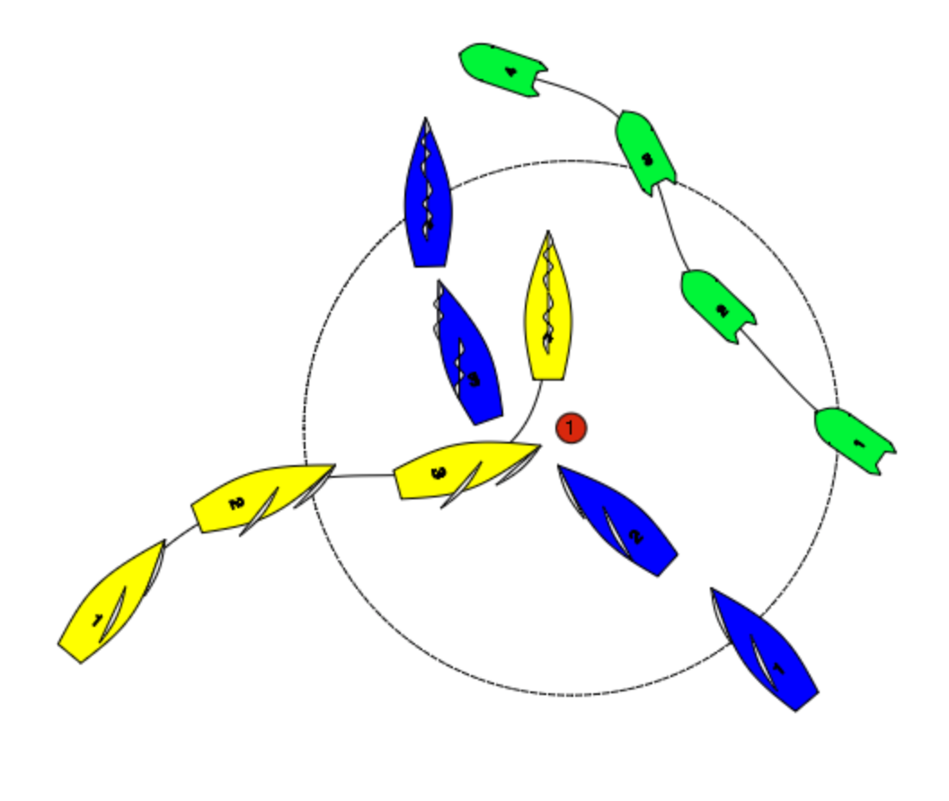
Hold Out –Opposite Tacks
Yellow passes astern of Blue.
Blue is not entitled to room.
Blue can not tack.
Green Flag
Umpire from above.

Slide 46
And YES as soon as Yellow is overlapped to leeward Blue must give her room.

Slide 47
No one protests!
Although Yellow was not given mark room, as there was no protest the umpires should do nothing.
What do you do?

Slide 48
Back to the Course

Slide 49
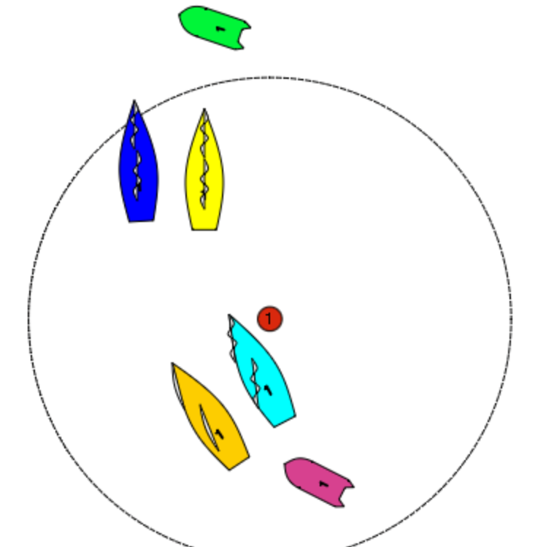
Leading Umpire
Keeps watching the gap.. Be aware of pair swapping…Umpire 2 keep to leeward…

Slide 50
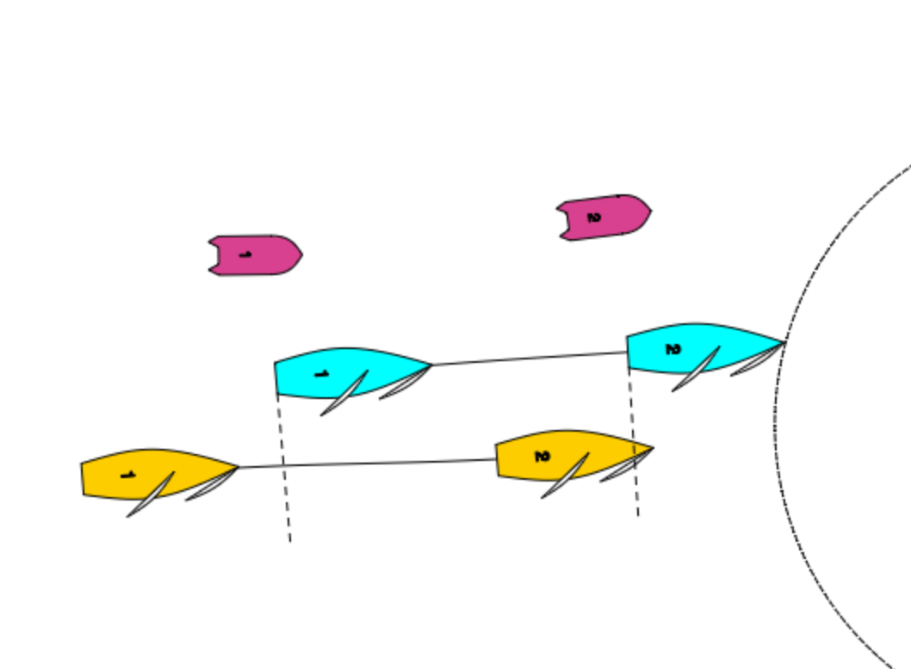
On the top reach with no RRS 17 Blue can be luffed

Slide 51
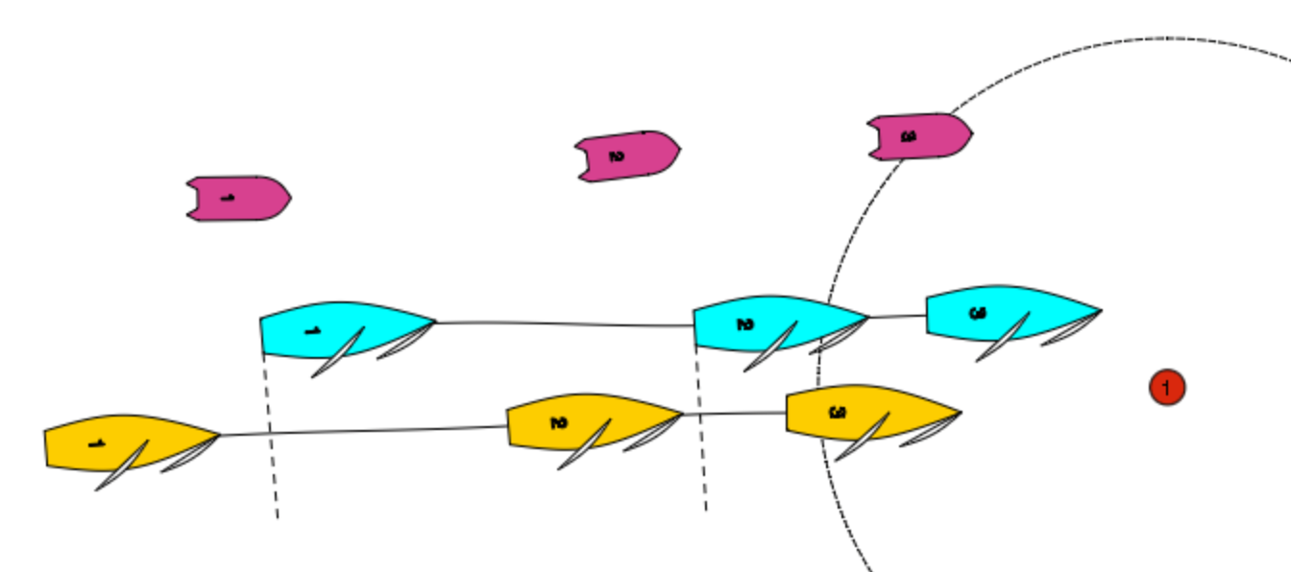
..but now Yellow must give Blue “Mark Room”

Slide 52
The Run
What are we going to see?

Slide 53
Remember No RRS17
Luffing is the main attack tactic.
Key that umpires are positioned to see the gap.
Only 15, 16 and 11 apply

Slide 54
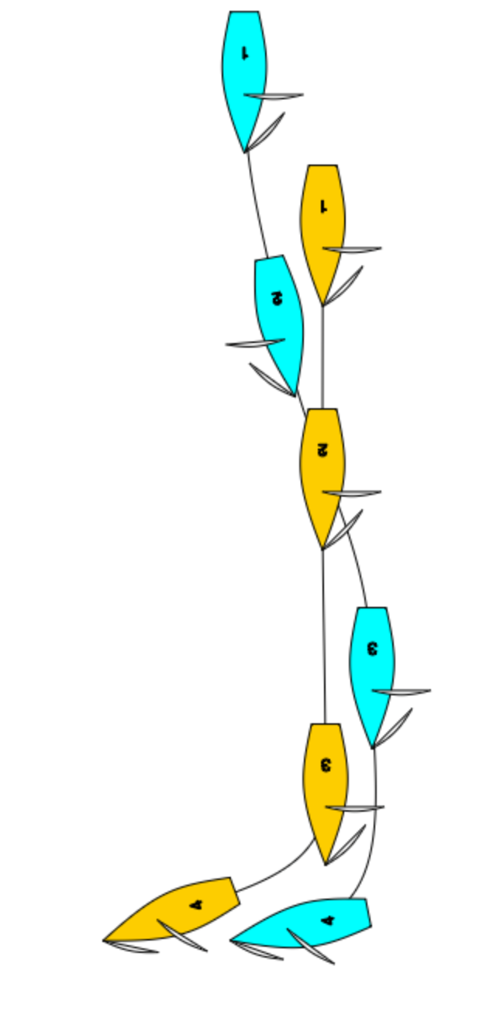
This is what you may see

Slide 55
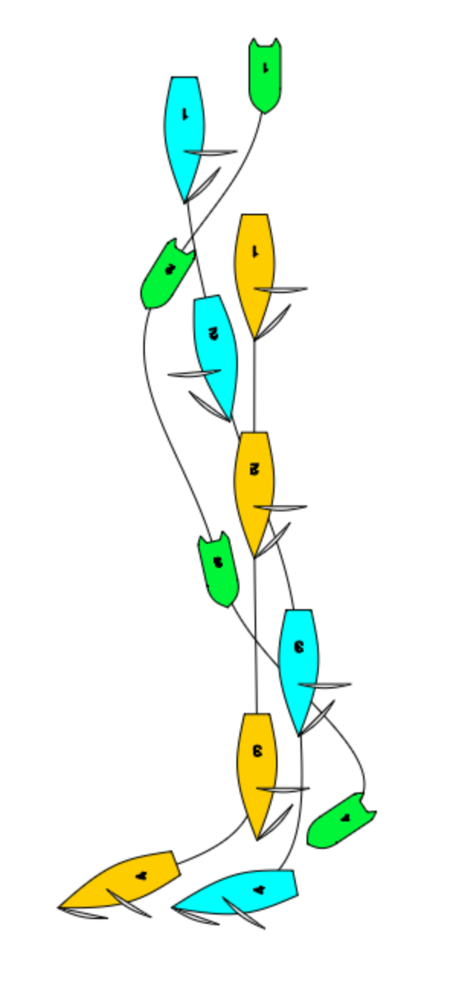
This is where you must be.

Slide 56
THE RUN
Attacks come from the right, so the leading umpire needs to be with the leading boat. The other umpire astern of the other pair.

Slide 57
At the leeward mark…who has Mark Room?
EVERYONE

Slide 58
16.2 on the run
What do you think of this?

Slide 59
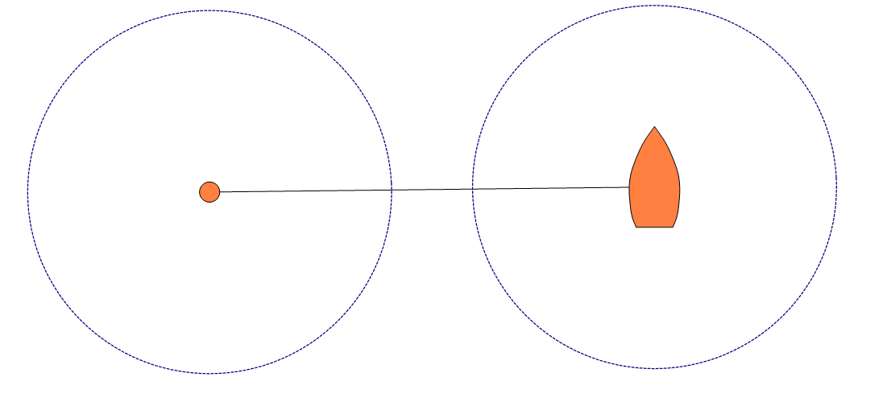
The Finish Line

Slide 60
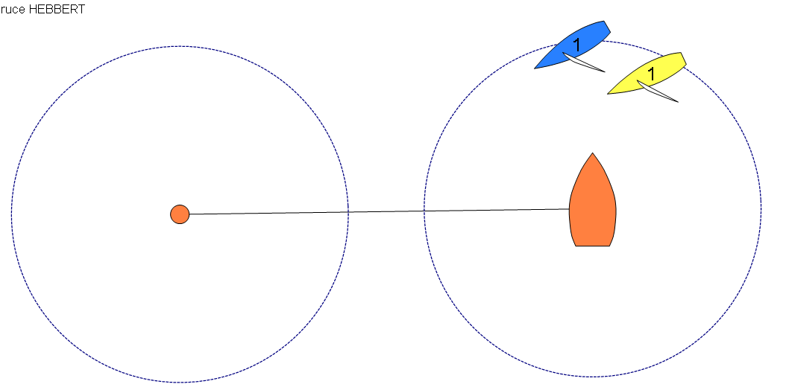
The Opportunities 1
Yellow: Inside Starboard…can luff? Remember no 18.4

Slide 61
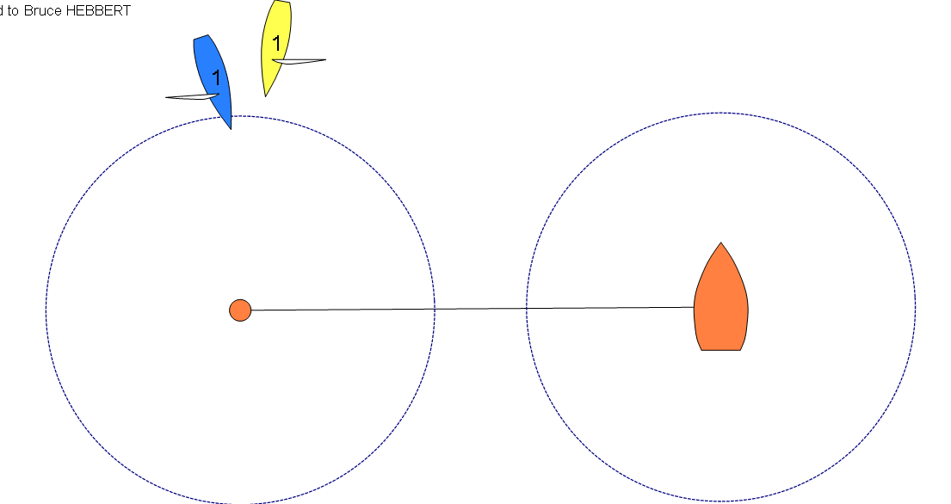
The Opportunities 2
Yellow:Is starboard…but Blue has mark room.

Slide 62
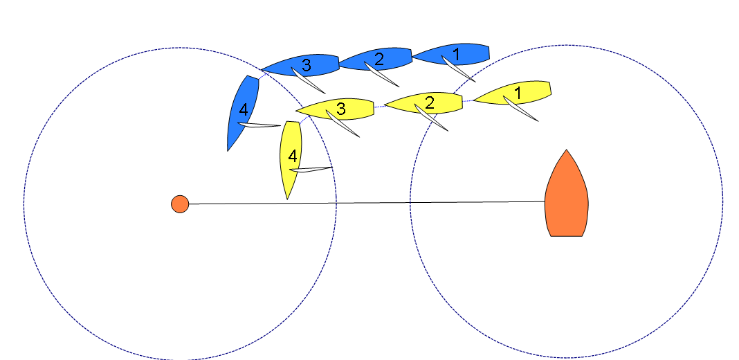
The Limitations 1
Yellow Is starboard can luff until position 3…but then Blue has mark room.

Slide 63
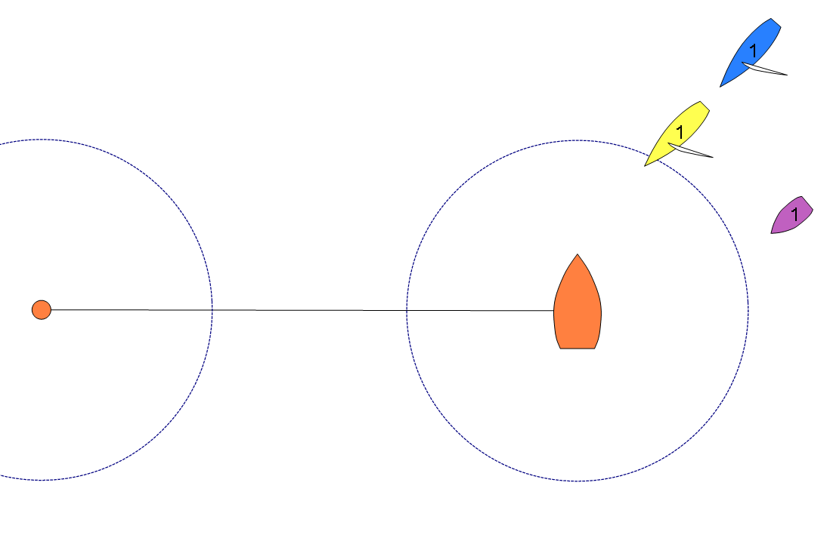
Where to be at the finish..Boat End
Below: to see the zone entry and overlap

Slide 64
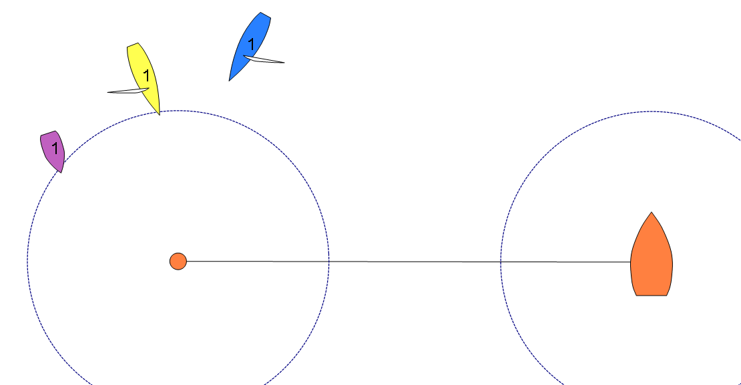
Where to be at the finish..Pin End
Below: to see the zone entry and overlap / Opposite tacks

Slide 65
What about this?

Slide 66
Remember
Everything that goes up has to come down

Slide 67
At the finish…generally better not to get too close.

Slide 68
…and YES Blue has MARK ROOM

Slide 69
Finally… Advantage
In some situations a team in last place by taking a voluntary or umpire imposed penalty ends up in 3rd place.
Or going into a situation it is being controlled, but by doing a penalty is in control.
Give additional penalties to place them behind the boat they infringed.
Hail “Advantage” so the boat knows why.

Slide 70
GOOD LUCK-ENJOY

